Slide 1
CS 355/555
Probability and Statistics for Computer Scientists
Baocheng Geng
Lecture 23, 03/19/2025
CS 355/555Probability and Statistics for Computer Scientists

Slide 2
Copyright Statement
Copyright Statement
Materials prepared for and/or included in this course are protected by copyright law. They are intended to be used only by students enrolled in this course during the current term and should not be further disseminated without prior permission from the course instructor.
CS 355/555Probability and Statistics for Computer Scientists

Slide 3
Announcement:
Midterm 2, March 31

Slide 4
The Normal Distribution
Here is a “normal” or “Gaussian” distribution
CS 355/555Probability and Statistics for Computer Scientists
5/40

Slide 5
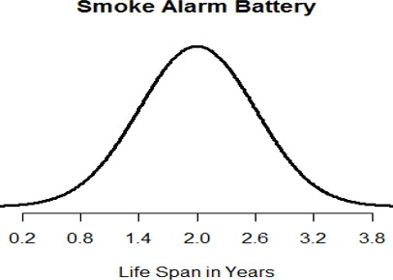
The Normal Distribution
Here is a “normal” or “Gaussian” distribution
It is called a “bell shaped curve” because it is symmetric and looks like a bell...
CS 355/555Probability and Statistics for Computer Scientists
5/40

Slide 6
The Normal Distribution
They y-axis represents the relative probability of observing a battery that has short/average/long life span.
CS 355/555Probability and Statistics for Computer Scientists
6/40

Slide 7
The Normal Distribution
They y-axis represents the relative probability of observing a battery that has short/average/long life span.
It is relatively rare to observe super short/long life span.
CS 355/555Probability and Statistics for Computer Scientists
6/40

Slide 8
The Normal Distribution
More examples of Normal Distribution Weight
Height
Pizza delivery times Scores on IQ tests
More: https://studiousguy.com/real-life-examples-normal-distribution/
CS 355/555Probability and Statistics for Computer Scientists
7/40

Slide 9
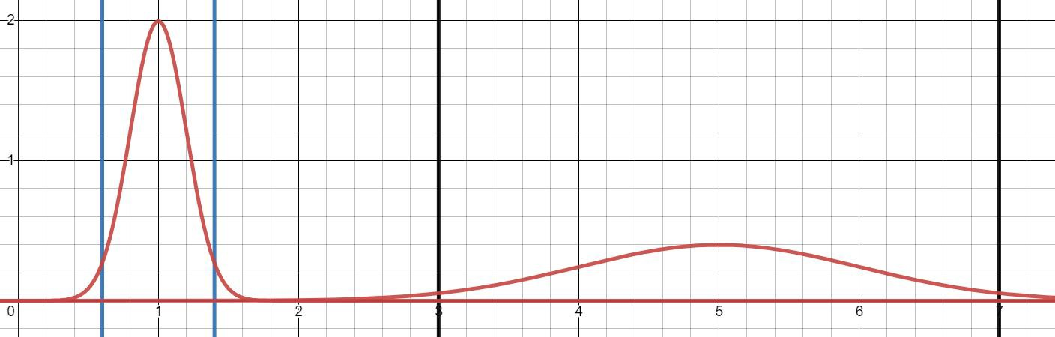
The Normal Distribution
Figure: Two normal distributions of the life span of single use battery (left) and rechargeable battery (right)
There is a high probability that a single use battery has life span between 0.6 and 1.4
CS 355/555Probability and Statistics for Computer Scientists
10/40

Slide 10
The Normal Distribution
Figure: Two normal distributions of the life span of single use battery (left) and rechargeable battery (right)
There is a high probability that a single use battery has life span between 0.6 and 1.4
There is a high probability that a rechargeable battery has life span between 3 and 7
CS 355/555Probability and Statistics for Computer Scientists
10/40

Slide 11
The Normal Distribution
Figure: Two normal distributions of the life span of single use battery (left) and rechargeable battery (right)
There is a high probability that a single use battery has life span between 0.6 and 1.4
There is a high probability that a rechargeable battery has life span between 3 and 7
The left curve is way tall compared to the right curve.
CS 355/555Probability and Statistics for Computer Scientists
10/40

Slide 12
The Normal Distribution
Figure: Two normal distributions of the life span of single use battery (left) and rechargeable battery (right)
The width of the curve is defined by the standard deviation
Left: σ_{S} = 0.2, right: σ_{R}=1
CS 355/555Probability and Statistics for Computer Scientists
11/40

Slide 13
The Normal Distribution
Figure: Two normal distributions of the life span of single use battery (left) and rechargeable battery (right)
The width of the curve is defined by the standard deviation
Left: σ_{S} = 0.2, right: σ_{R}=1
95% of the measurements fall between ±2σ around the mean
CS 355/555Probability and Statistics for Computer Scientists
11/40

Slide 14
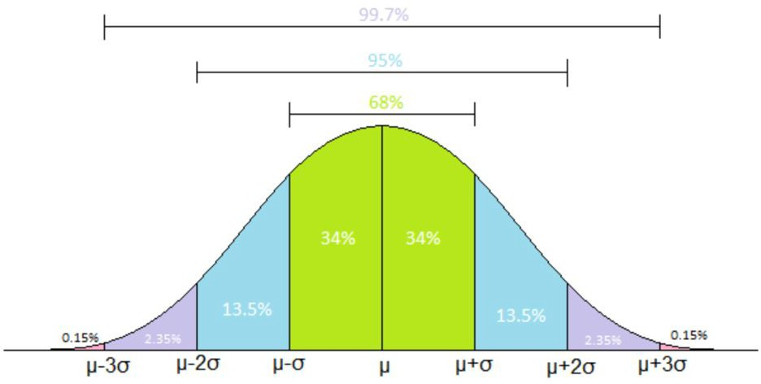
The Normal Distribution
68-95-99.7 Rule
CS 355/555Probability and Statistics for Computer Scientists
13/40

Slide 15
The Normal Distribution
68-95-99.7 Rule
P (X < µ + σ) = 34% + 34% + 13.5% + 2.35% + .15% = 84%
CS 355/555Probability and Statistics for Computer Scientists
13/40

Slide 16
The Normal Distribution
68-95-99.7 Rule
P (X < µ + σ) = 34% + 34% + 13.5% + 2.35% + .15% = 84%
P (Single use battery will last longer than 1.2 years) = 1 − 84% = 16%
CS 355/555Probability and Statistics for Computer Scientists

Slide 17
The Normal Distribution
To draw a normal distribution, you need to know:
The average measurement: where the center of the curve locates
The standard deviation of the measurements: how wide the curve should be. Also, the width of the curve determines how tall it is.
The wider the curve, the shorter the curve. The narrower the curve, the taller the curve.
CS 355/555Probability and Statistics for Computer Scientists

Slide 18
The Normal Distribution
Warning
Horrendous equation following
Don’t try to memorize this.
CS 355/555Probability and Statistics for Computer Scientists

Slide 19
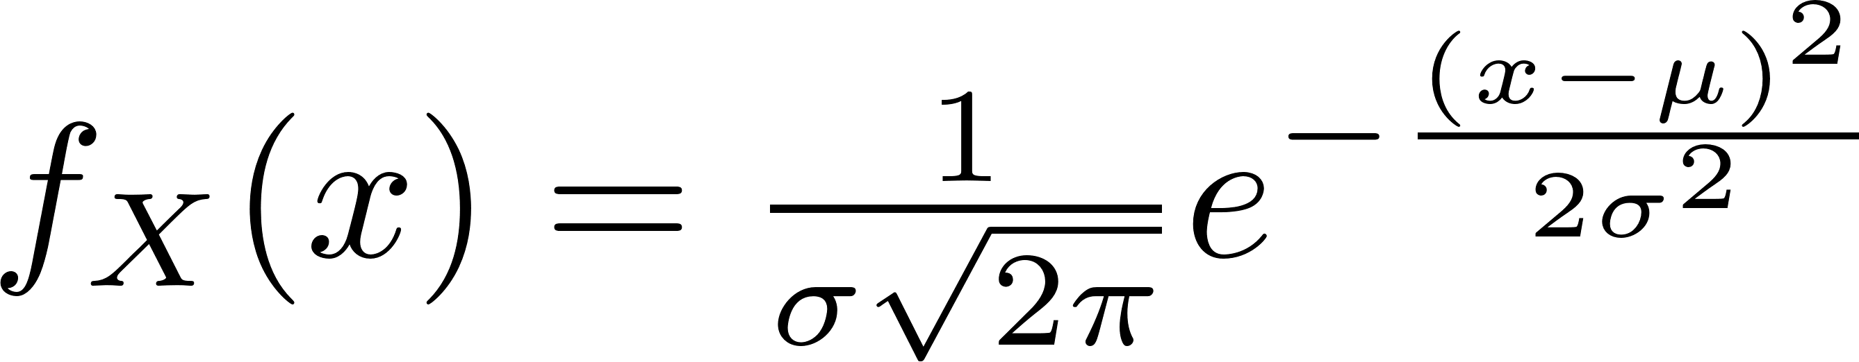
The Normal Distribution
The PDF of normal distribution
The Normal Distribution has mean µ and standard distribution σ that define the curve.
CS 355/555Probability and Statistics for Computer Scientists

Slide 20

The Normal Distribution
The PDF of normal distribution
∞
f (x) = 1
−∞
X
E[X] = µ, V ar(X) = σ²
Symmetric about the mean
f_{X} (µ − c) = f_{X} (µ + c)
P (X < µ − c) = P (X > µ + c)
f_{X} (x) > 0 for all x
CS 355/555Probability and Statistics for Computer Scientists
17/40

Slide 21
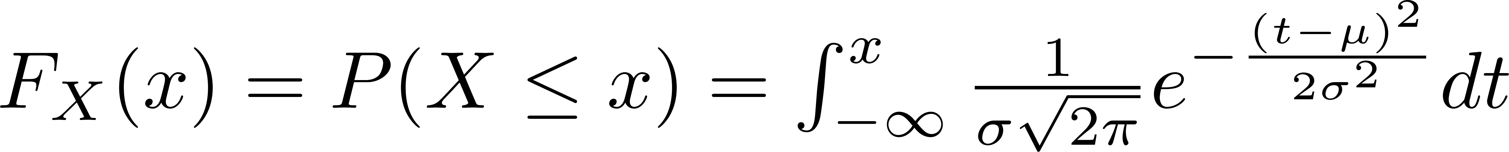
The Normal Distribution CDF
The CDF of normal distribution
CS 355/555Probability and Statistics for Computer Scientists

Slide 22
The Normal Distribution
Normality is preserved by Linear Transformations
If X is a normal random variable with mean µ and variance σ², and if
a , b are scalars, then the random variable
Y = aX + b
is also normal, with mean and variance
E[Y ] = aµ + b var(Y ) = a²σ²
CS 355/555Probability and Statistics for Computer Scientists

Slide 23
A normal random variable Y with mean zero and variance 1.
Standard Normal Distribution
Standard Normal Random Variable
CS 355/555Probability and Statistics for Computer Scientists
20/40

Slide 24
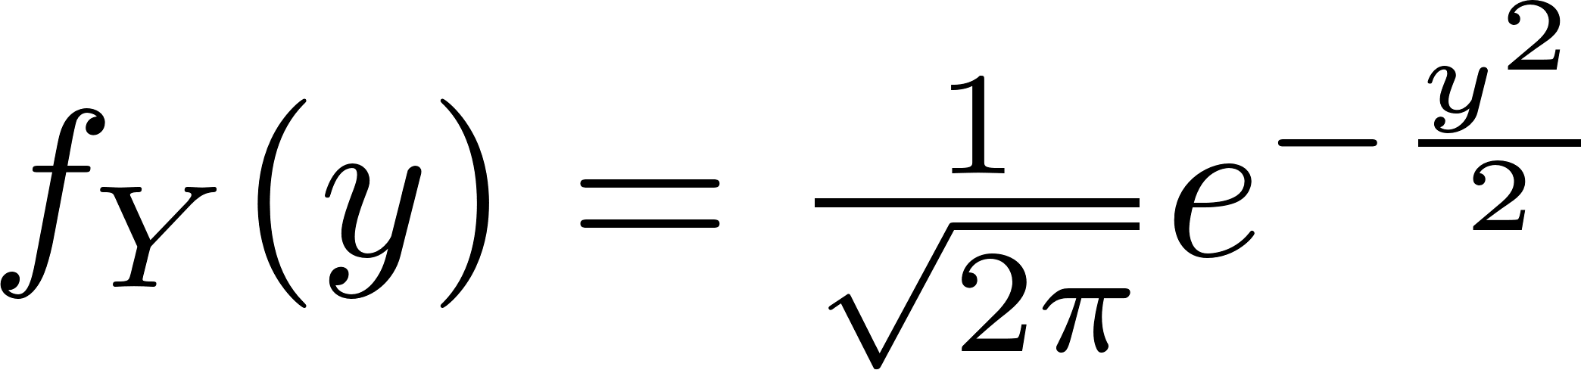
Standard Normal Distribution
Standard Normal Random Variable
A normal random variable Y with mean zero and variance 1.
PDF of Standard Normal Random Variable
The CDF of standard normal
CS 355/555Probability and Statistics for Computer Scientists
20/40

Slide 25
Standard Normal Distribution
Standard Normal Random Variable
A normal random variable Y with mean zero and variance 1.
PDF of Standard Normal Random Variable
The CDF of standard normal
CS 355/555Probability and Statistics for Computer Scientists
20/40

Slide 26
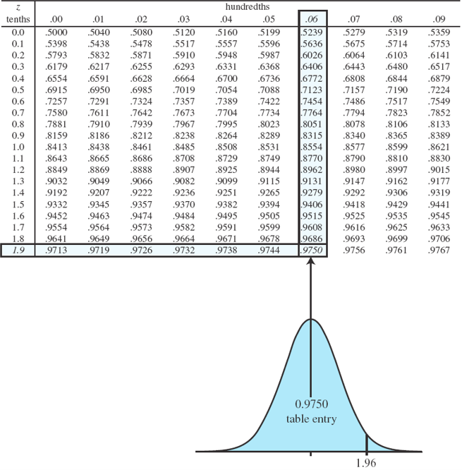
The Standard Normal Table (pg 155)
CS 355/555Probability and Statistics for Computer Scientists

Slide 27
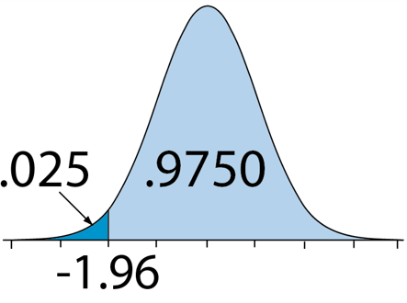
The Standard Normal Table (pg 155)
The table only provides the values of Φ(y) for y ≥ 0. The
remaining values can be found using the symmetry of the PDF Φ(−1.96) = P (Y ≤ −1.96) = P (Y ≥ 1.96) = 1 − P (Y < 1.96)
= 1 − Φ(1.96) = 1 − 0.975 = 0.025
CS 355/555Probability and Statistics for Computer Scientists

Slide 28
The Standard Normal Table (pg 155)
More generally, Φ(−y) = 1 − Φ(y), for all y
CS 355/555Probability and Statistics for Computer Scientists

Slide 29
The Standard Normal Table (pg 155)
In almost every case for the rest of our lives we won’t need to refer to a table like this, except for a rare example in an old text.
Almost any modern computer platform has a function Phi. Use it.
CS 355/555Probability and Statistics for Computer Scientists
24/40

Slide 30
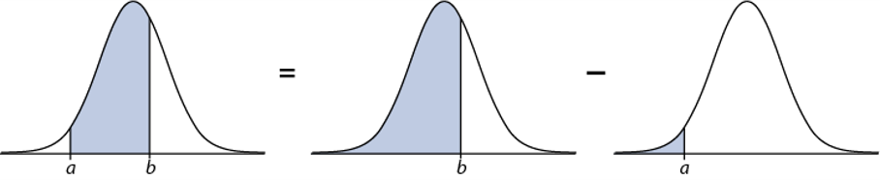
The Standard Normal RV: Probabilities between Points
a, b are scalars that represent the lower/upper boundaries
P (a ≤ Y ≤ b) = P (Y ≤ b) − P (Y ≤ a) = Φ(b) − Φ(a)
CS 355/555Probability and Statistics for Computer Scientists

Slide 31
The Standard Normal Distribution
P (−1 < Y < 1) = P (Y < 1) − P (Y < −1) = 2Φ(1) − 1 = 0.6826 P (−2 < Y < 2) = P (Y < 2) − P (Y < −2) = 2Φ(2) − 1 = 0.9544 P (−3 < Y < 3) = P (Y < 3) − P (Y < −3) = 2Φ(3) − 1 = 0.9974
CS 355/555Probability and Statistics for Computer Scientists

Slide 32
Standardize a Normal Random Variable
Let X be a normal random variable with mean µ and variance σ². We “standardize” X by defining a new random variable Y given by
X − µ
Y =
σ
CS 355/555Probability and Statistics for Computer Scientists
27/40

Slide 33
Standardize a Normal Random Variable
Let X be a normal random variable with mean µ and variance σ². We “standardize” X by defining a new random variable Y given by
X − µ
Y =
σ Y is normal with mean and variance
E[X] − µ
E[Y ] = = 0,
var(X)
var(Y ) = = 1
σ
_{σ}2
CS 355/555Probability and Statistics for Computer Scientists
29/40

Slide 34
Standardize a Normal Random Variable
Let X be a normal random variable with mean µ and variance σ². We “standardize” X by defining a new random variable Y given by
X − µ
Y =
σ Y is normal with mean and variance
E[X] − µ
E[Y ] = = 0,
var(X)
var(Y ) = = 1
σ
_{σ}2
It allows us to calculate the probability of any event defined in terms of X: we redefine the event in terms of Y , and then use the standard normal table.
CS 355/555Probability and Statistics for Computer Scientists
29/40

Slide 35
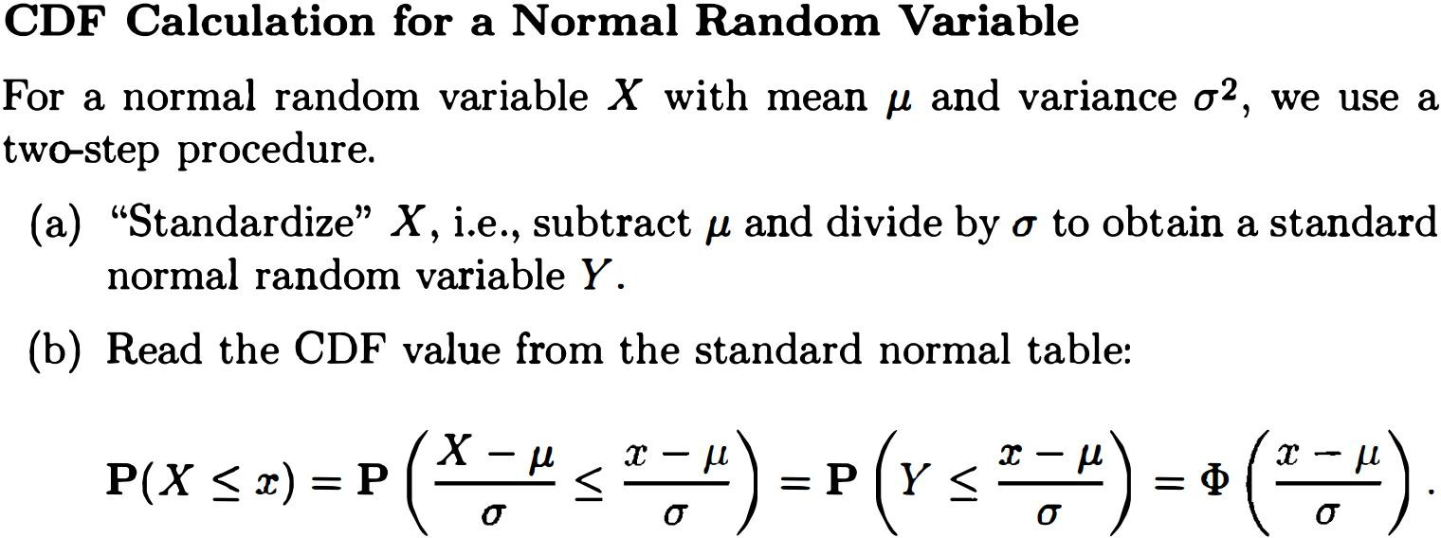
CDF of a Normal Random Variable (pg157)
CS 355/555Probability and Statistics for Computer Scientists
30/40

Slide 36
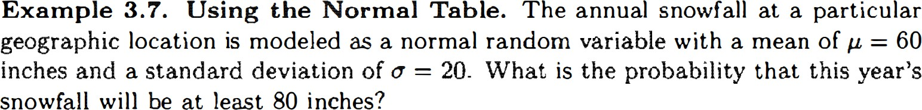
Example 3.7, pg 156
CS 355/555Probability and Statistics for Computer Scientists

Slide 37
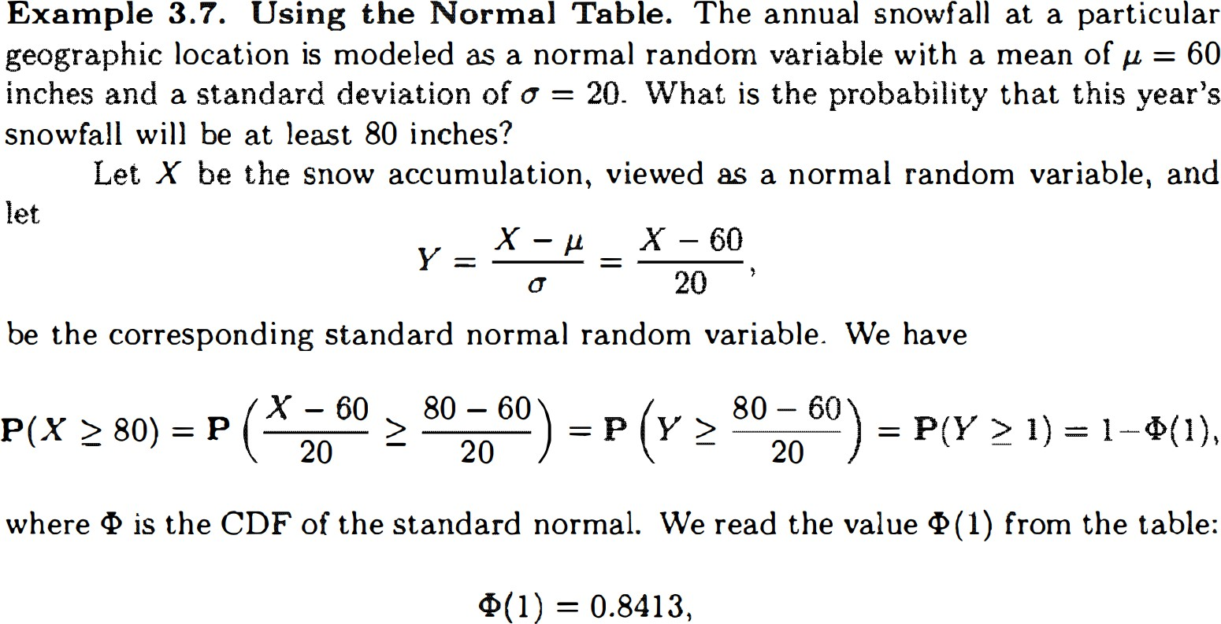
Example 3.7, pg 156
CS 355/555Probability and Statistics for Computer Scientists
32/40

Slide 38
Example 3.7, pg 156
P (X ≥ 80) = .1587
CS 355/555Probability and Statistics for Computer Scientists
32/40

Slide 39
Important Message
Important Message
If this were a test or homework problem, stop at 1 − Φ(x)
CS 355/555Probability and Statistics for Computer Scientists

Slide 40
The Standard Normal in Python
Generate random variables
Compute the PDF and CDF of the standard normal distribution
CS 355/555Probability and Statistics for Computer Scientists

Slide 41
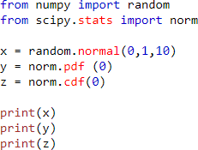
The Standard Normal in Python
Generate random variables
Compute the PDF and CDF of the standard normal distribution
CS 355/555Probability and Statistics for Computer Scientists

Slide 42
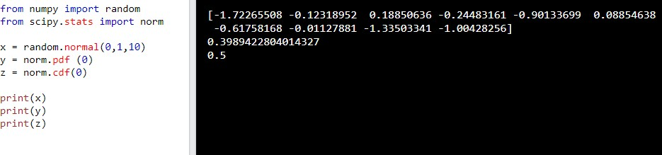
The Standard Normal in Python
CS 355/555Probability and Statistics for Computer Scientists

Slide 43
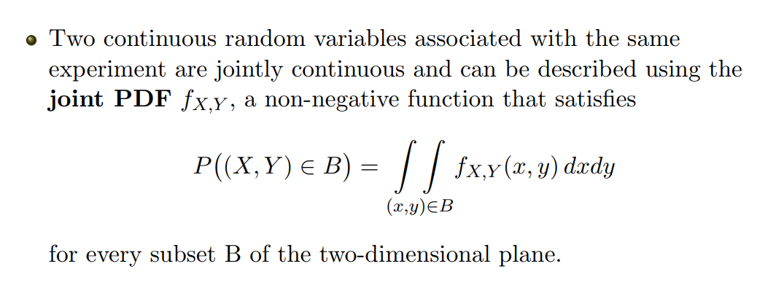
Joint PDF
CS 355/555Probability and Statistics for Computer Scientists

Slide 44
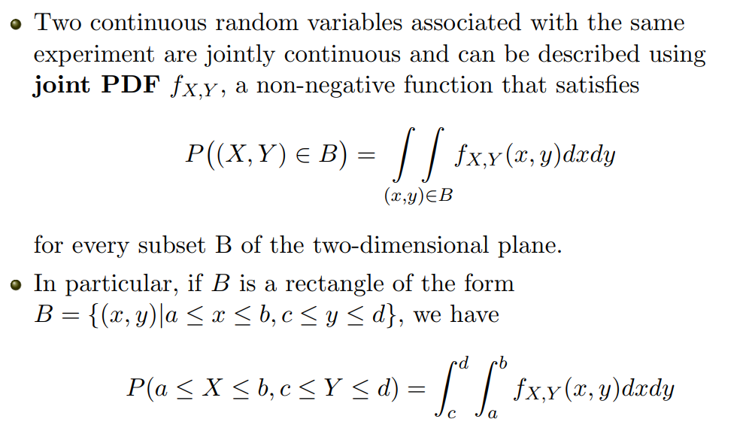
Joint PDF
CS 355/555Probability and Statistics for Computer Scientists

Slide 45
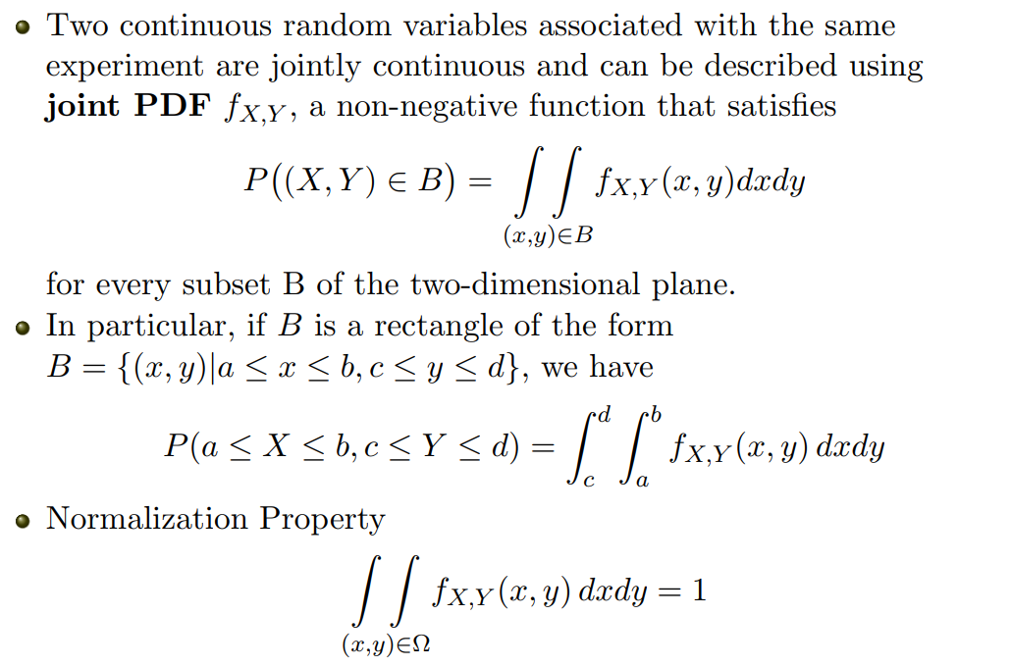
Joint PDF
CS 355/555Probability and Statistics for Computer Scientists

Slide 46
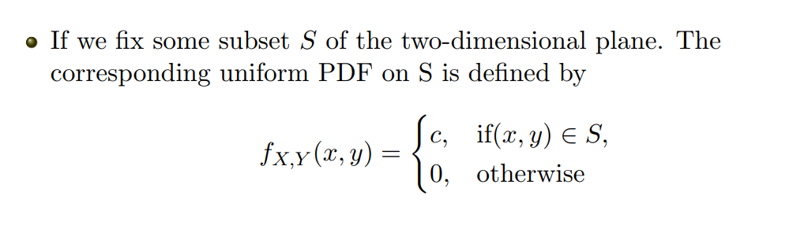
Uniform Joint PDF
CS 355/555Probability and Statistics for Computer Scientists

Slide 47
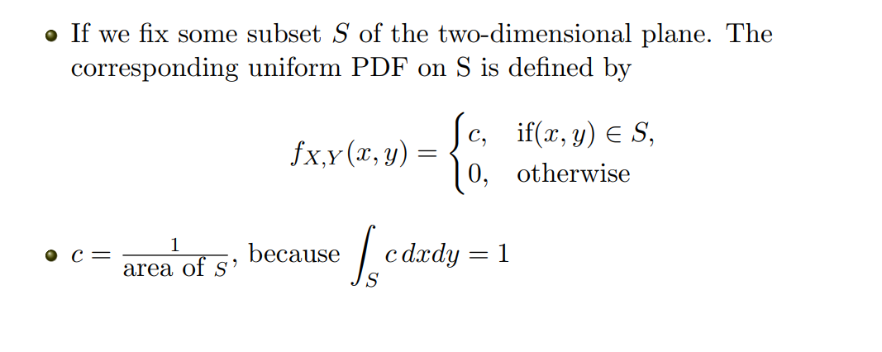
Uniform Joint PDF
CS 355/555Probability and Statistics for Computer Scientists

Slide 48
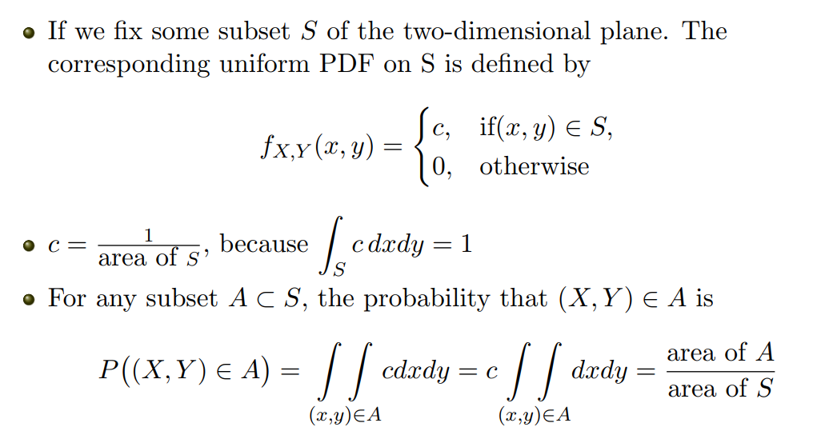
Uniform Joint PDF
CS 355/555Probability and Statistics for Computer Scientists

Slide 49
Example 3.10, pg 160
After class exercise
CS 355/555Probability and Statistics for Computer Scientists
12/1

Slide 50
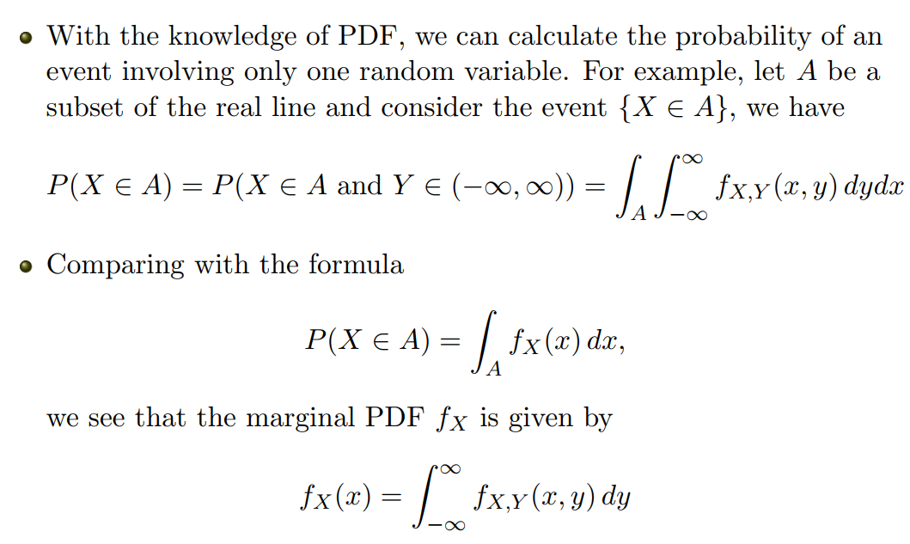
Marginal PDF
CS 355/555Probability and Statistics for Computer Scientists

Slide 51
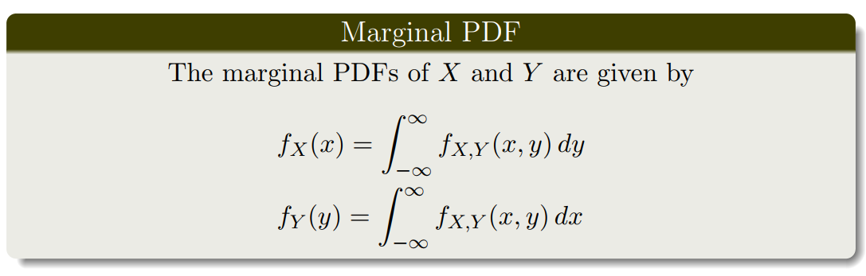
Marginal PDF
CS 355/555Probability and Statistics for Computer Scientists

Slide 52
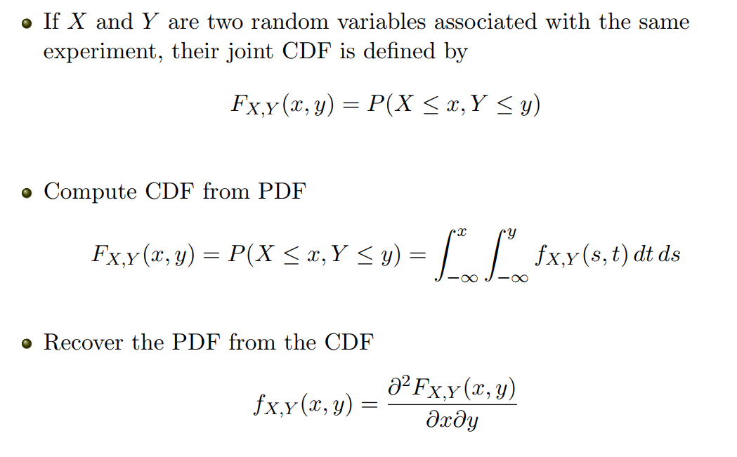
Joint CDF
CS 355/555Probability and Statistics for Computer Scientists

Slide 53
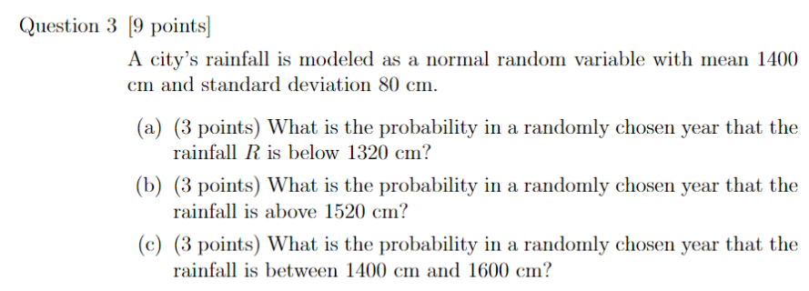
Quiz
CS 355/555Probability and Statistics for Computer Scientists

